Slide 1
COURSE
REGISTRATION
SYSTEM
Presented by- Team A
Trained by- Mr Amit Balyan

Slide 2
Industry Ready Training
8 WEEKS OF TECH & HANDS ON PROJECT
Everyday 45 minutes of Pulse Connect and discussion session with trainer about the track and technologies.
Everyday demonstartion of project progress report followed by extensive work review and doubt clearance session.
Viva tests on alternate days based on the last topic taught and daily assignments..
Problem statement followed throughout the journey as scope of project.
All 3 aspects- Technology, Delivery and Engineering to be covered in process.
Demonstration of final product where students will be assessed.

Slide 3
STAKEHOLDERS
Sponsors : GNIOT
Trainer: Mr Amit Balyan

Slide 4




OUR
JOURNEY
Understanding Project goals and learning basics like Core Java
Step 1
Deciding the technologies: JAVA/REST
Step 2
Design Thinking
And UML modelling
Step 3
Learning technologies and implemention
Step 4
Project Demonstartion
Step 5

Slide 5
TRACK OF BOOTCAMP
6th Week
Java, JDBC , Java tools & features
REST, Jersey & Postman
1st Week
3rd Week
Core Java UML Modelling Java
8th week
Git & Github
SDLC & OOAD
SQL
Object oriented design
MySQL colloborating with JDBC
2nd Week
4th Week
7th Week

Slide 6
PROJECT GOALS
To create COURSE REGISTRATION SYSTEM using Java where a student can choose courses followed by registration which can be completed using different payment modes.
Other primary actors of the project includes professor and admin where professor can choose subjects to teach whereas admin manages the administration.

Slide 7

OUR TEAM
Mr. Amit Balyan
Team A
Chirag Yadav
Nishant Kumar Singh
Rishabh Singh
Shahnawaz Khan

Slide 8





TECHSTACK

Slide 9
DEVELOPMENT

Slide 10
Project Delievery
DEVELOPMENT LIFECYCLE : SDLC
Integrate, deploy, test, documentation
Project Implementation
Software Development Life Cycle (SDLC) is a process used by the software industry to design, develop and test high quality softwares.
We use V-Model- Verification and model .
(testing phase for every development phase)
04
Development , Code Review, Commit
Project Grooming
03
Requirement understanding, analysis and estimation
02
Project Planning
01
Understanding scope and goals of project, UML modelling and database designing

Slide 11
UML MODELLING
As a part of software designing phase, we used UML modelling lanuage for representing problem into graphical form as per best engineering practices.

Slide 12
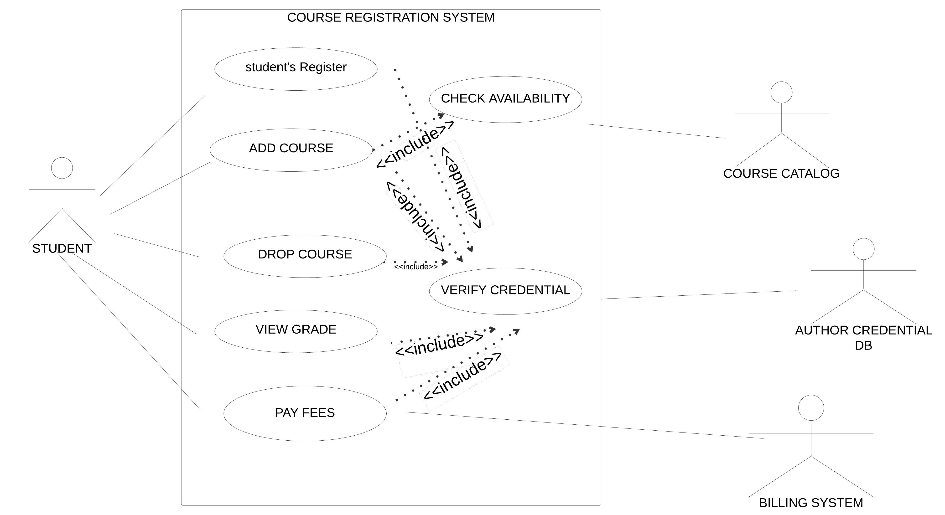
1. Use Case
Diagarms

Slide 13
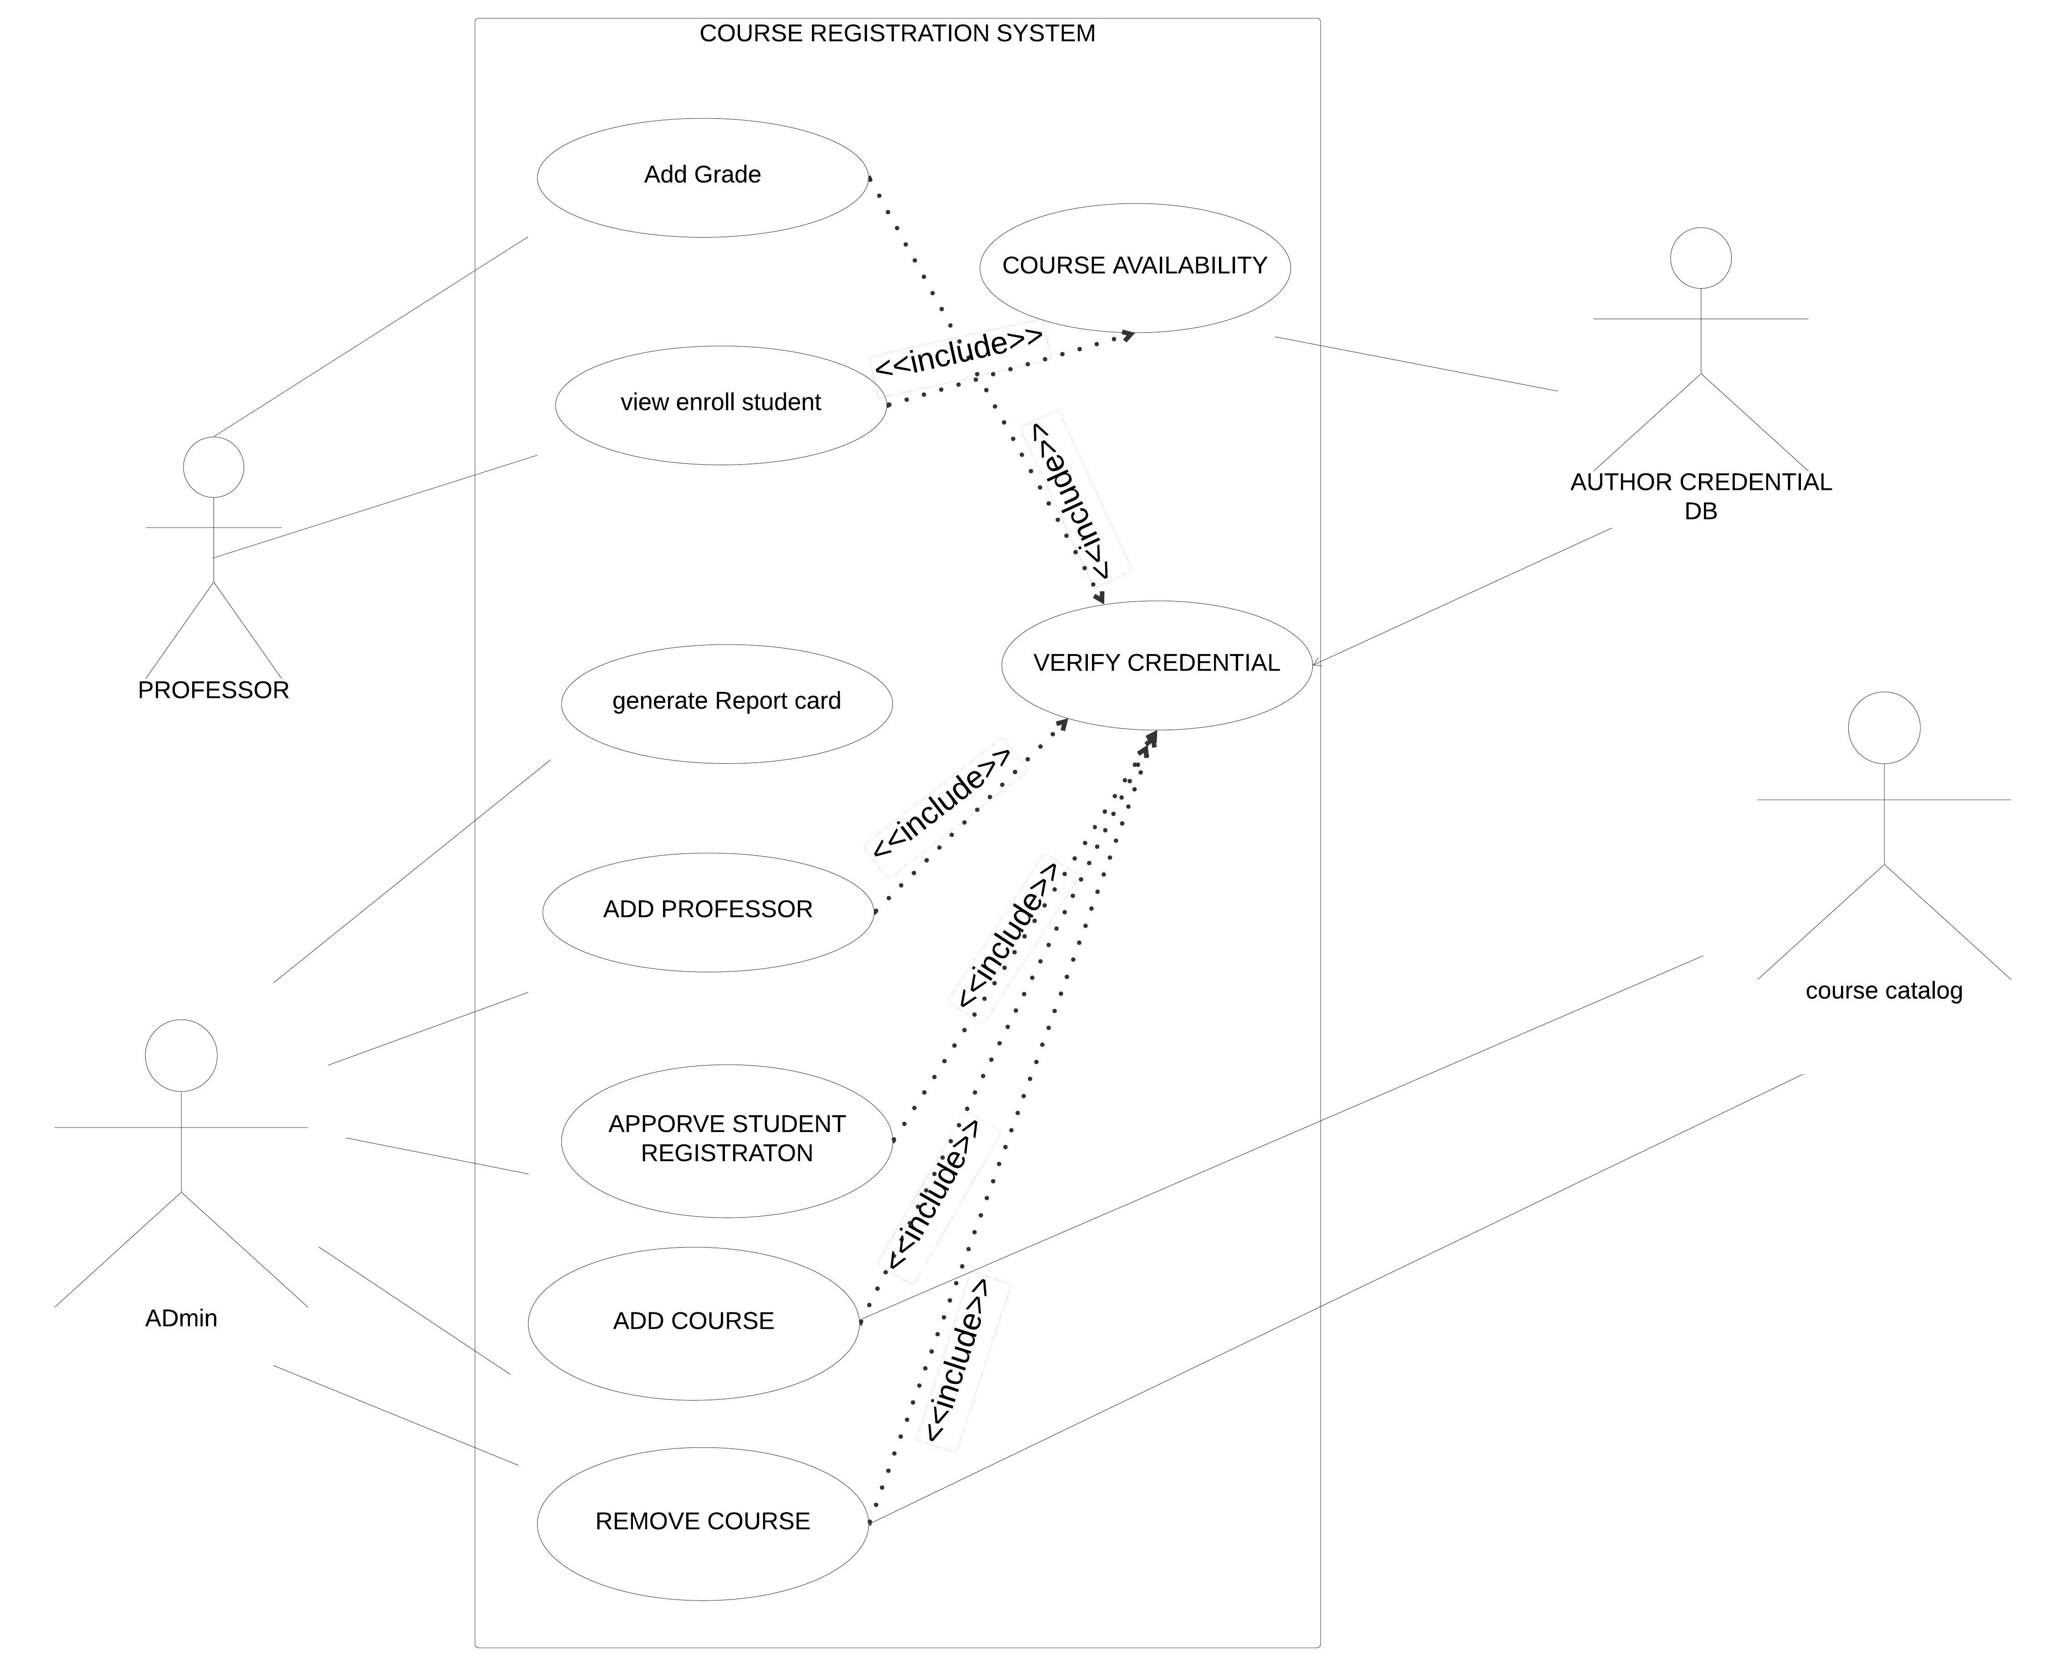

Slide 14
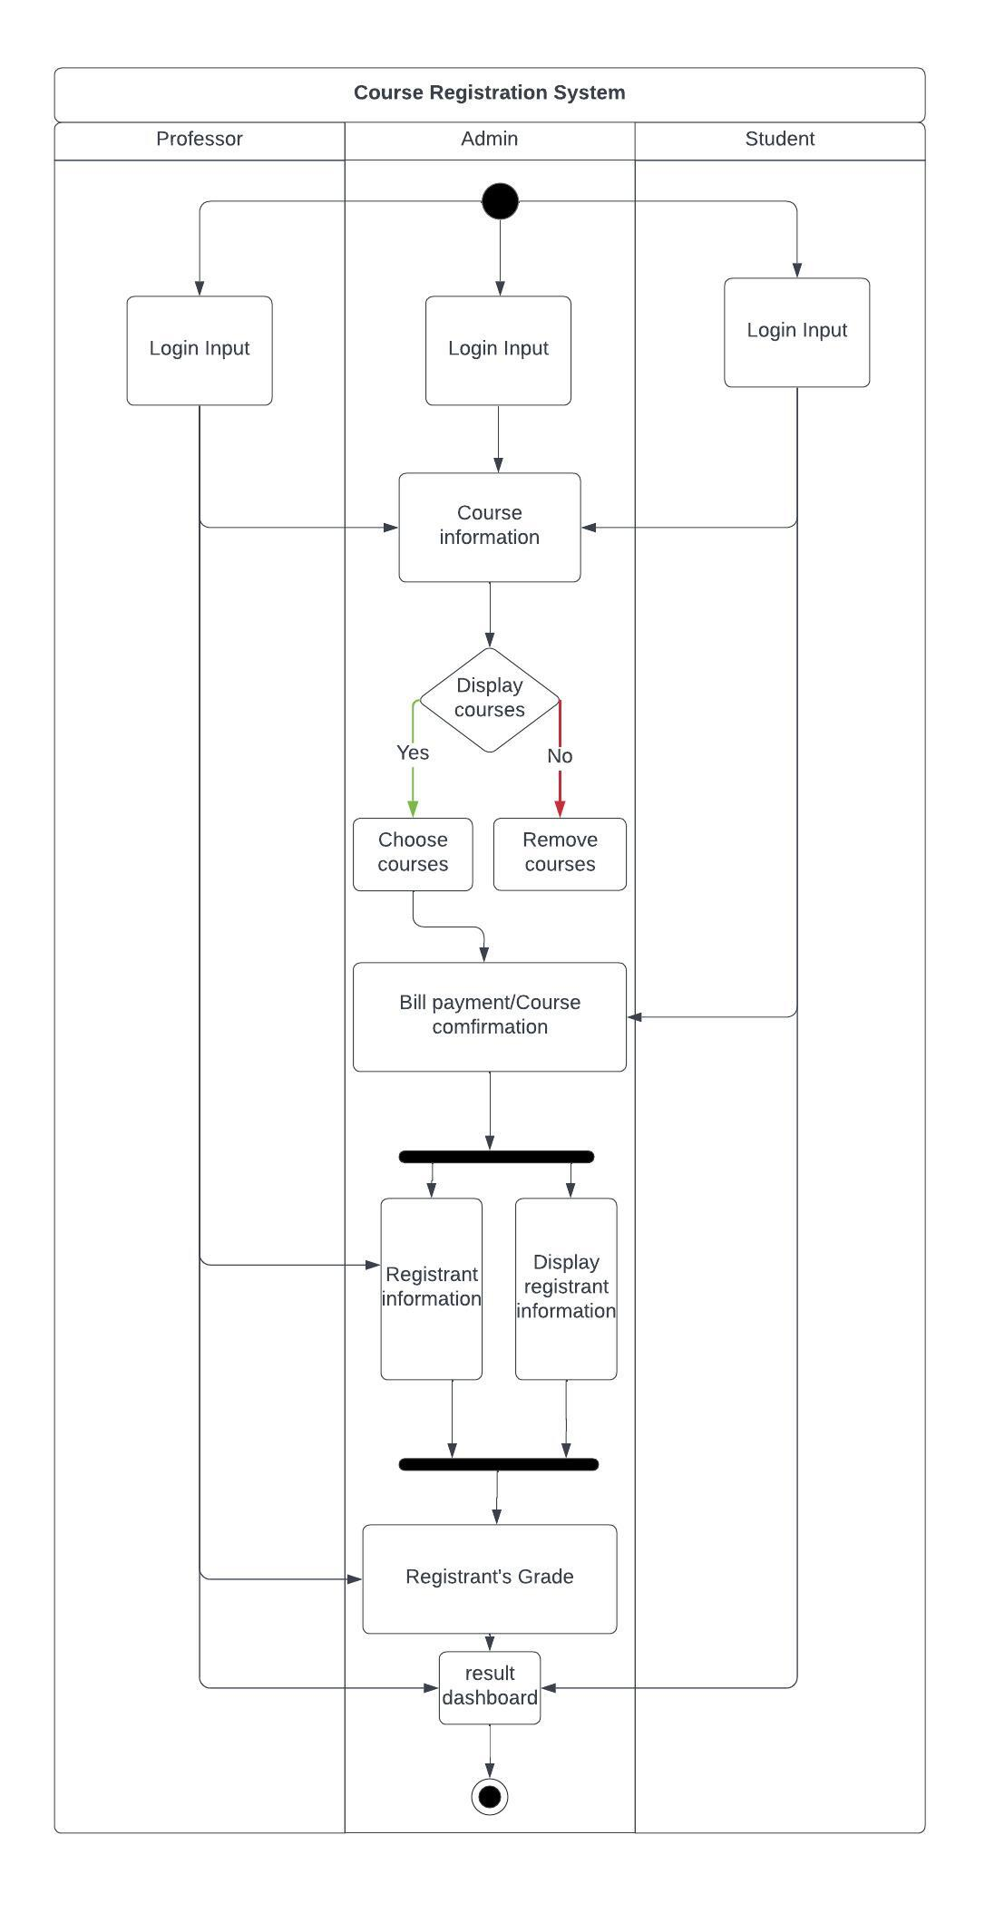
2. Activity
Diagrams

Slide 15
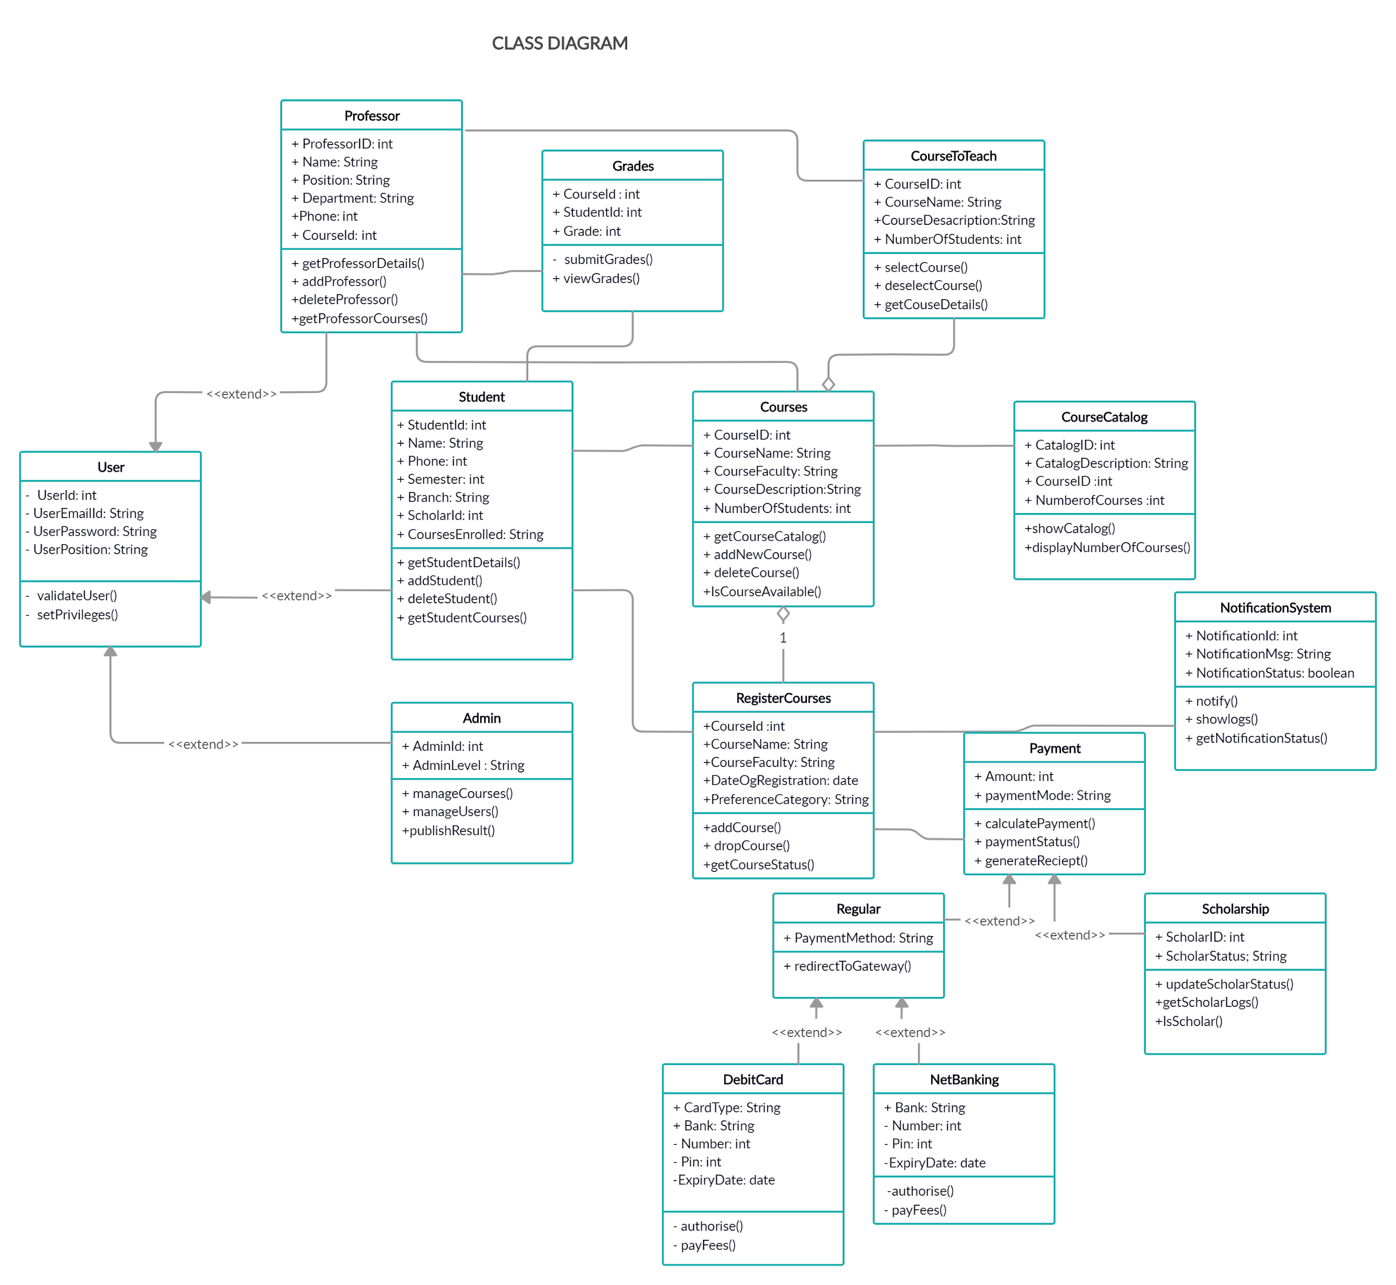
3. Class Diagram

Slide 16
DATABASE SCHEMA DESIGNING

Slide 17
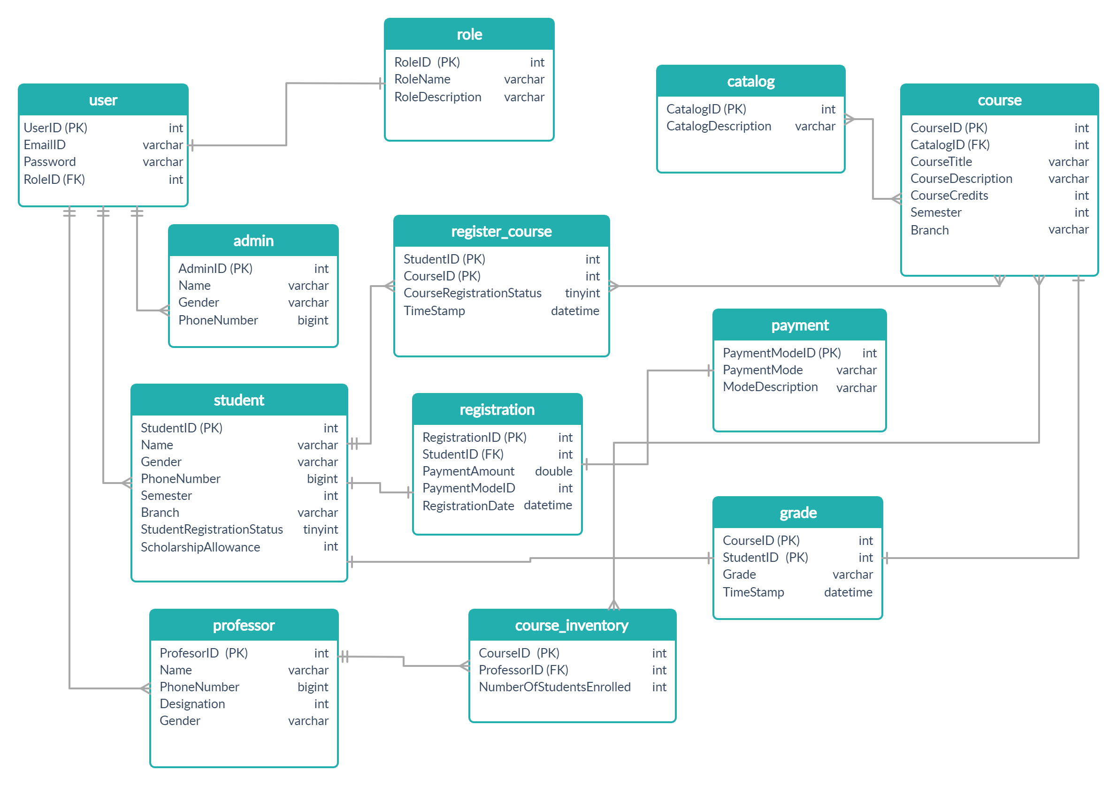

Slide 18
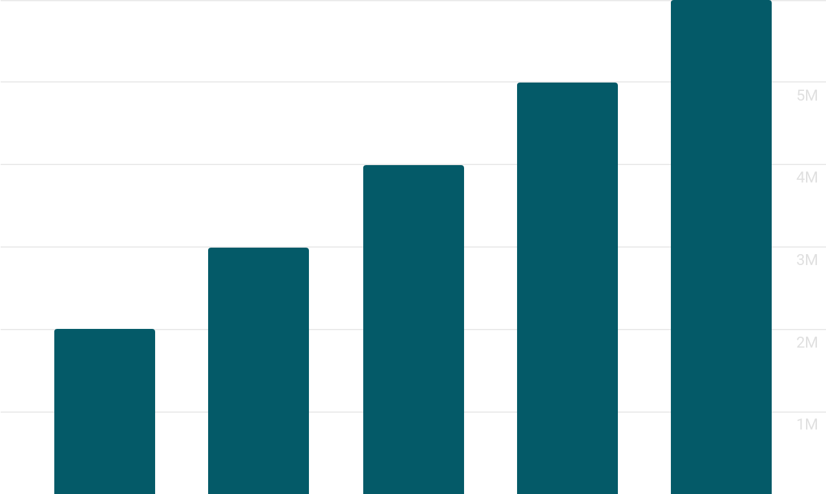
CHALLENGES
AND LEARNING
2012
2015
2018
2020
2022

Slide 19

Challenges
Learning in virtual environment
Setting up of environment
Resolving the errors and refactoring the code in case of major changes

Slide 20
The Transformation
N number of amateur drafts before the final UML diagrams drafting.
Code writing got better with every single day...
Drastic improvement in the skills of database designing -Normalisation.
Different practices of debugging.. Finally we know how to operate our own written code.
Documentation is important !

Slide 21
Net Gains
Hands on “theory”
Learnt the best practices to write code in accordance with design patterns and OOD principles.
Learnt about “separation of concern”- how each class holds its own responsibility.
Hands on some completely new frameworks and APIs.
Learnt how OOAD can help in providing flexibility to code where changes can be made without affecting entire project.
.

Slide 22
Let’s begin with demo
s

Slide 23
THANKS
Do you have any questions?

